Slide 1
Astro-2: History of the Universe
Lecture 1; April 2 2013

Slide 2
Astro-2: History of the Universe
Instructor: Prof. Tommaso Treu
Lectures: TR 2:00-3:15PM Broida 1640
Office hours: TR 9:00-10:00 Broida 2015F
TA: Jared Brooks
Discussion Sections:
M 6:00-6:50 BSIF 1217
R 5:00-5:50 BSIF 1217
Office hours: WF 1:30-3:00
FINAL EXAM: June 11 2013 4:00-7:00

Slide 3
Astro-2: History of the Universe
Textbook:
Universe, 9th Edition, Freedman and Kaufmann
Astro 1 is required: you are responsible for knowing the contents of Universe up to chapter 23 (17-23 in particular)
Website: www.physics.ucsb.edu/~tt/ASTRO2
Power point files and reading assignments can be found on the website

Slide 4
Astro-2: History of the Universe
Grading:
25% Homework and discussion sessions
5% Class participation
15% midterm-1 (April 25 2013)
15% midterm-2 (May 16 2013)
40% final exam (June 11 2013)
5% extra credit
Special events (2.5% extra credit each. Instructions on the web):
Star parties at SBMNH
Las Cumbres Lecture by Shri Kulkarni. SBMNH May 9 2013 7:30PM

Slide 5
Astro-2: History of the Universe
Homework assigned on thursdays is due on Fridays 4:00PM of the following week (details from the TA)
Class participation is essential. Ask questions! There are no stupid questions!!!
Grades as in Table. Absolute grades, no “curve”
A+ | 95% | C+ | 60%
A | 90% | C | 55%
A- | 85% | C- | 50%
B+ | 80% | D | 40%
B | 75% | F | <40%
B- | 70%

Slide 6
Astro-2: The big question

Slide 7
Astro-2: More big questions
Is the Universe evolving?
If so, how and when did it form?
How big/old is the universe?
How/when did galaxies/stars/planets form?
Is there extraterrestrial life in the Universe?

Slide 8
Astro-2: physical cosmology
Cosmology uses all the knowledge of physics that we learn from laboratory experiments
Some of the most extraordinary discoveries in physics come from cosmology: dark matter and dark energy, just to name two
The subject of the discipline is unique: we only have one Universe, we cannot replicate/alter/reproduce our “sample”
We can only do experiments and measurements from one specific point in time and space

Slide 9
Astro-2: Tools of the trade – Telescopes as time machines

Slide 10
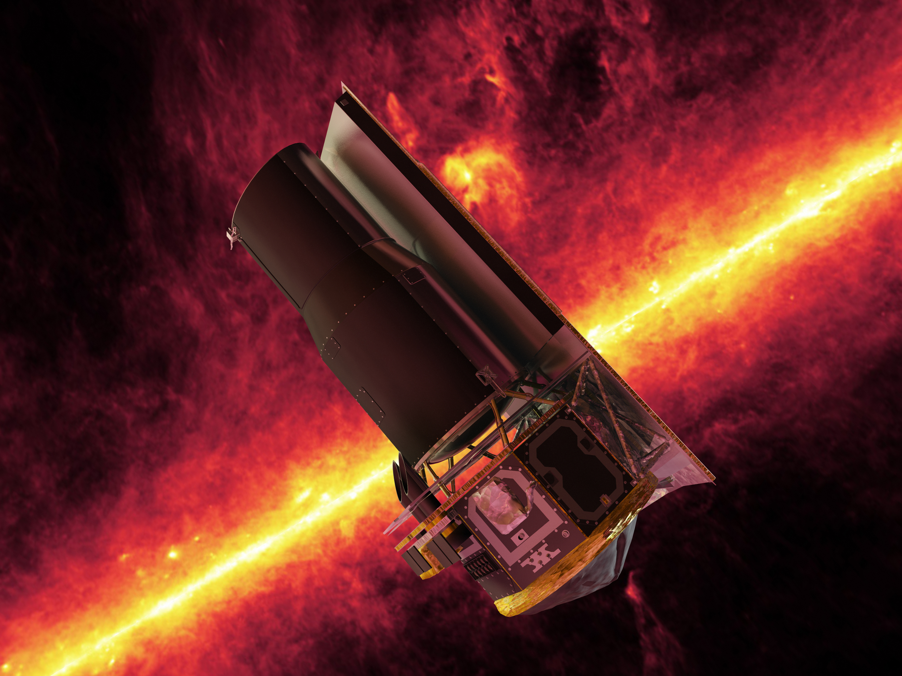
Astro-2: A golden era for cosmology

Slide 11
Astro-2: cosmology itself evolves..

Slide 12
Astro-2: our view of the universe changes quite dramatically
1929: The universe is expanding
1998: the universe is accelerating

Slide 13
Astro-2: observational cosmology
Experiments and Observations force us to modify/change our view of the Universe. Examples:
Galileo’s observations of sun spots proved that the heavens are not time-invariant
Hubble’s measurement of galaxy redshifts showed that the Universe is not static
High speed motions of stars in galaxies show that either we do not understand gravity or there is a large amount of “dark matter”, i.e. different stuff that the ones that makes you and me (and Earth)

Slide 14
Astro-2: A fundamental dilemma
Experiments and Observations can only be made from a very special point in space and time: Earth now.
Yet we would like to construct a scientific theory that describes the universe everywhere and at all times.

Slide 15
Astro-2: and its solution
Physicists postulate a universal principle: our local sample of the universe is no different from more remote and inaccessible places
This postulate is deeply rooted in two fundamental principles of physics:
The laws of physics (whatever they are!) do not depend on space and time
Physical explanations of natural phenomena should be as simple as possible (Occam’s razor)

Slide 16
Astro-2: Cosmological Principles
1) Cosmological (Copernican) principle: the universe is homogeneous and isotropic

Slide 17
Astro-2: Cosmological Principles
2) Perfect cosmological principle: The universe is homogenous, isotropic, and time-invariant
Inconsistent with observations!

Slide 18
Astro-2: Cosmological Principles
3) Anthropic cosmological principle:
The fact that we exist to observe the universe makes now a special point in time.
We can use this fact to explain some properties of the Universe. (quantum mechanics “on steroids”)
This is a grey area of physics and not commonly accepted as physical explanation.

Slide 19
The End
See you on Thursday!

