Slide 1
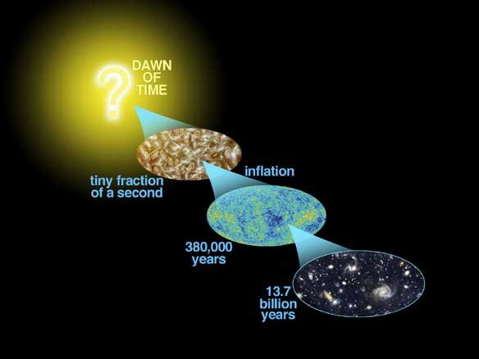
Astro-2: History of the Universe
Lecture 10; May 14 2013

Slide 2
Previously… on astro-2
If the universe is homogenous and isotropic and correctly described by General Relativity:
At any given time the universe is a 3D space
It could be open/close/flat
If it is close, its volume is finite. If it is open or flat its volume is infinite.
In any case THERE IS NO CENTER AND THERE ARE NO EDGES

Slide 3
Previously… on astro-2
In the Big Bang model the “size” of the universe evolves according to the Friedmann equation.
Knowing the current value of the cosmological parameters (cosmography) we can calculate the past history of the Universe and predict its future.
The simplest models (e.g. Einstein-de Sitter) don’t work because, e.g., they predict an age for the universe that is in conflict with the ages of globular clusters

Slide 4
Previously… on astro-2
The cosmological constant was initially introduced by Einstein to find a static solution for the universe (but it’s unstable!!)
When the universe was shown to expand the idea was abandoned
The cosmological constant was brought back by MEASUREMENTS less than a decade ago
Most people prefer to interpret the cosmological constant as dark energy and to give it a “particle physics” interpretation rather than a geometric one

Slide 5
Today.. On Astro-2.
Cosmography. How do we measure the cosmological parameters?
  Standard rods and standard candles
  Volume based tests and cluster based tests
  Cosmic Background Radiation
The era of concordance cosmology. Happy campers?
Acceleration and horizons. Big rip?

Slide 6
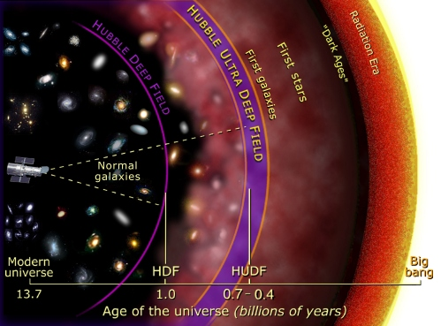
Cosmography and distances
In a normal euclidean space how does observed flux F scale with distance R?
F=L/4πR²
How about angular sizes?
θ=D/R
What happens in the universe in the classic big bang picture?

Slide 7
Cosmography and distances
In an expanding universe, even if it is flat, things are a bit trickier because the universe changes as light travels across it.
In practice there is no unique definition of distance
By analogy with the Euclidean static space people define a luminosity distance as
F=L/4πR_{L}²
And an angular size distance
θ=D/R_{A}
These are NOT the same.

Slide 8
Cosmography and distances
The relationship between distance and redshift depends on the cosmological parameters.
For example?
Hubble’s Law: zc ~ H₀ R for low z
At higher z this depends also on all the other cosmological parameters
So what do we need?

Slide 9
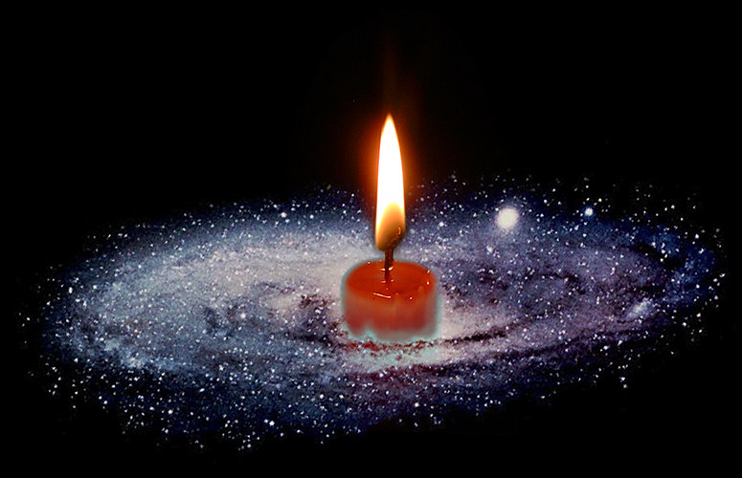
Cosmography and distances
We need some object of known luminosity (or size)
Standard candle (or rod).
Then we measure its redshift and its flux (or angular size) and we infer the cosmological parameters
What is a good standard candle?
SN Ia

Slide 10
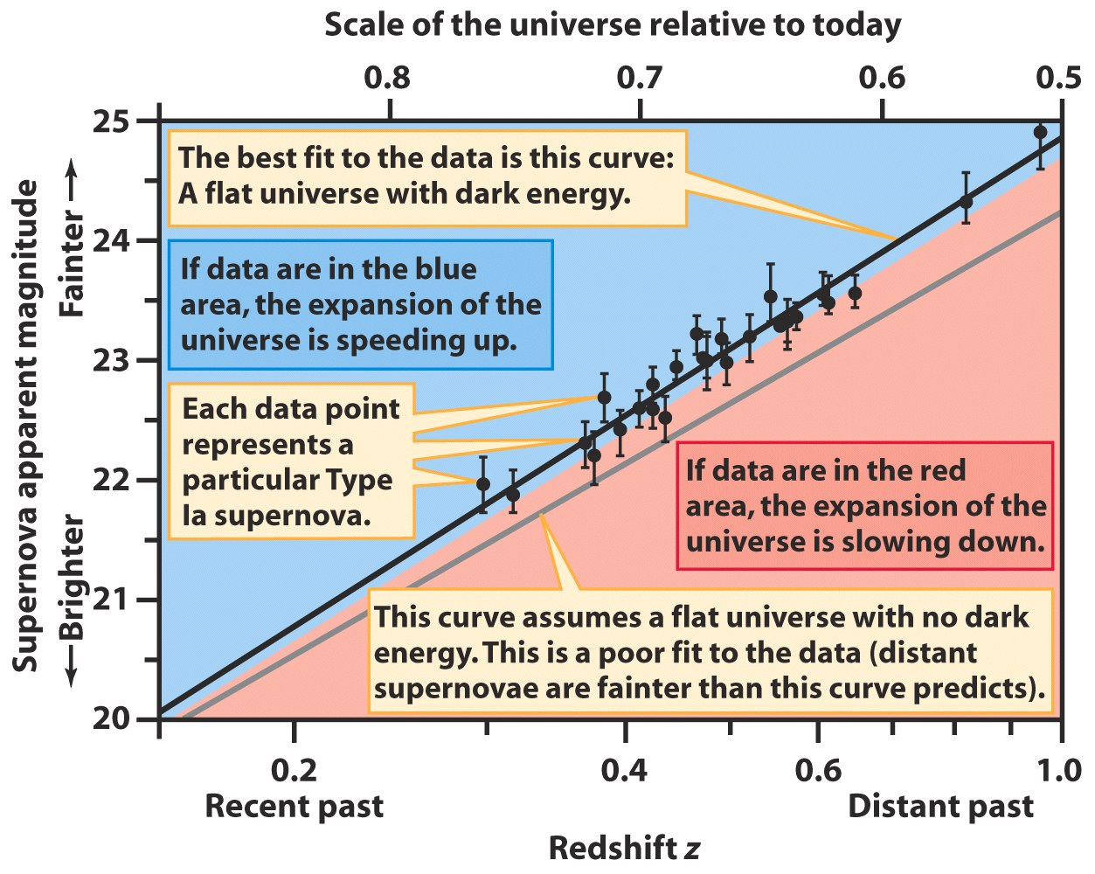
Cosmography and distances. Sn Ia
Supernovae Ia are believed to be standard candles.
That is, when they explode they always produce a very similar amount of light

Slide 11
Cosmography and distances. Sn Ia
The fact that supernovae at high-z appear fainter that we expect for a “normal” expanding universe is interpreted by many as evidence that the expansion is accelerating.
Any other interpretation?

Slide 12
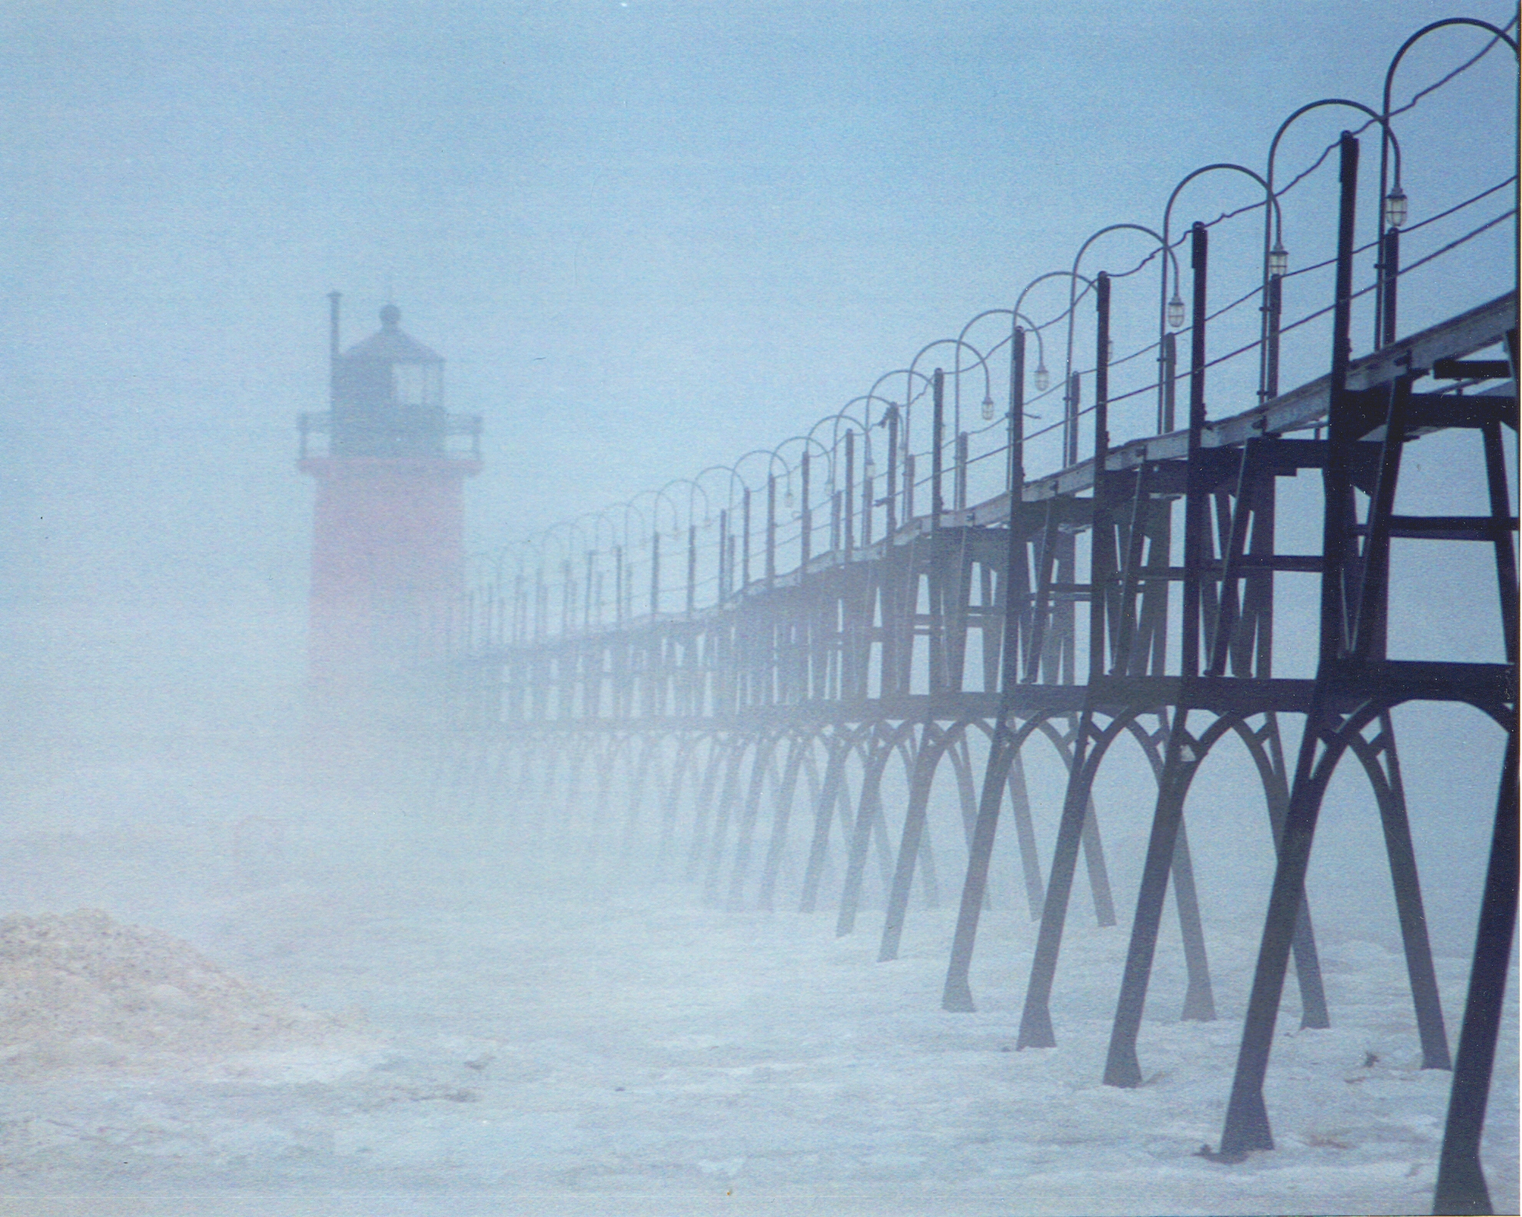
Cosmography and distances.
Sn Ia and systematics
Evolution of the progenitors
Dust screen

Slide 13
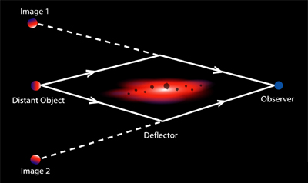
Cosmography and distances. Future: gravitational time delays?

Slide 14
Cosmography and distances. Summary
In an expanding universe the relationship between redshift and distance depends on the cosmological parameters (i.e. the geometry and expansion of the universe).
Every reliable standard candle or rod can provide you with an answer.
The most popular at the moment are Supernovae Ia. They look dimmer than expected in the past indicating that the universe is accelerating
This is the so called “Cosmic jerk”

Slide 15
Cosmography, volume, and the growth of structures
In a normal euclidean space how does the volume within a distance R scale with R?
V~R³
In an expanding Universe things get a bit “tricky”. As you look further away the universe was smaller… so volumes scale with redshift in a more complicated way.
This depends on?

Slide 16
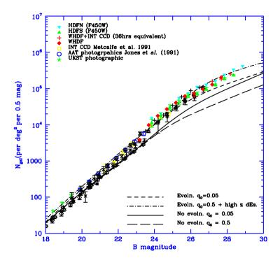
Cosmography, volume, and the growth of structures
So if you have a uniform population of objects of known luminosity and you look fainter and fainter you should see more of them because you are looking at a larger volume.
This is attempted with galaxies for example.
But there is a problem. What?

Slide 17
Cosmography, volume, and the growth of structures
The problem is evolution, there is no uniform population of galaxies! So this does not work very well.
However, we can use evolution to do cosmography
In fact, large scale structures evolve due to gravity.
The more mass the faster the evolution.
Therefore the abundance of structure as a function of cosmic time can be used to measure the matter density of the universe

Slide 18
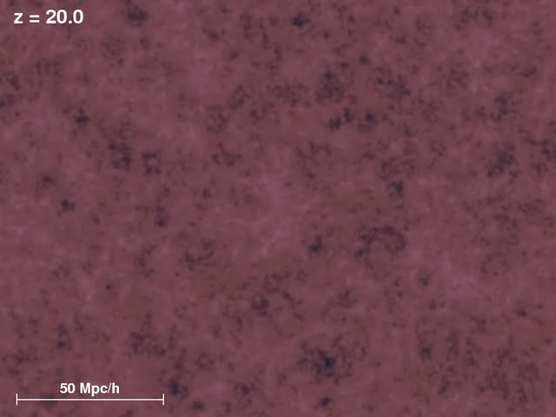
Cosmography, volume, and the growth of structures

Slide 19
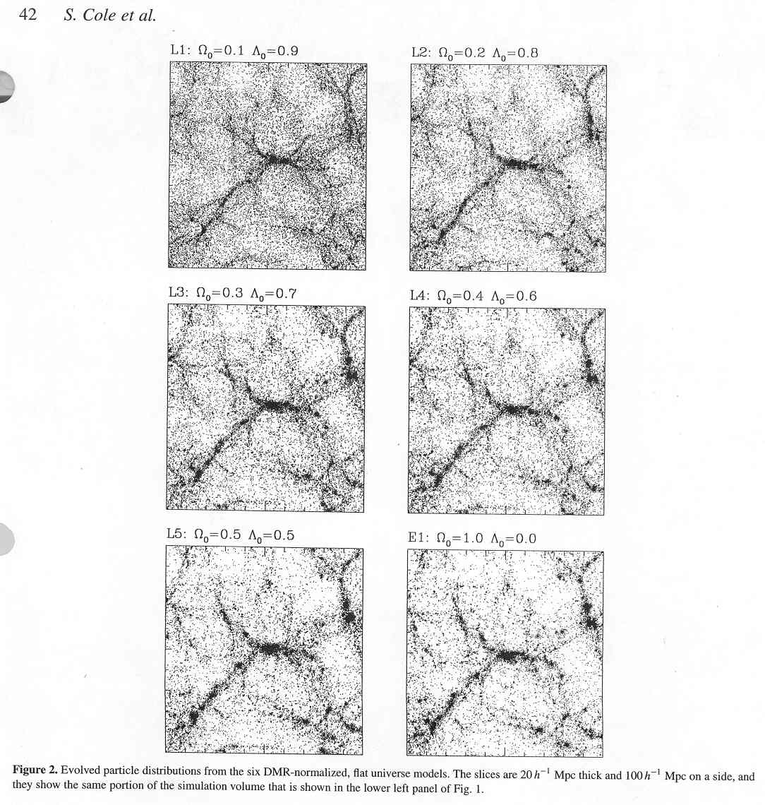
Cosmography, volume, and the growth of structures

Slide 20
Cosmography, volume, and the growth of structures
Cosmography can be done by measuring (e.g.):
  statistical properties of large scale structures
  Cluster abundance and its redshift evolution
Each method of course has limitations so it is important to apply more than one!

Slide 21
Cosmography, volume, and the growth of structures. Summary
The volume of the universe as a function of redshift depends on the cosmological parameters, so can be used to do cosmography.
Another approach is to measure the properties of the large scale structure of the universe and the abundance and evolution of density peaks (clusters). This is a sensitive measure of the matter density of the universe. (And the laws of gravity!)
These two approaches are useful but difficult to do in practice. It is important to have more than one method.

Slide 22
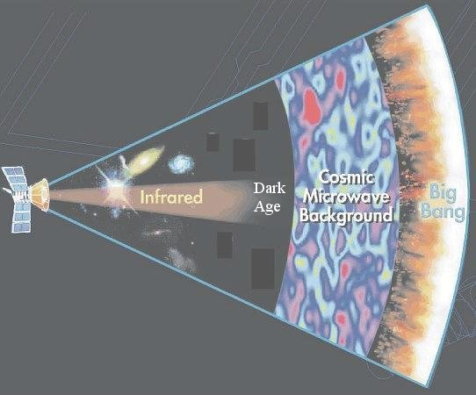
Cosmic Microwave Background as a cosmic “yardstick”
As we have seen earlier the universe is filled with a homogeneous and isotropic radiation field (blackbody at T~3K) the CMB.
The anisotropy of the CMB contains an incredible amount of information about the history of the early universe, its content and geometry.
To understand how this is possible, we need to understand what exactly is the CMB.

Slide 23
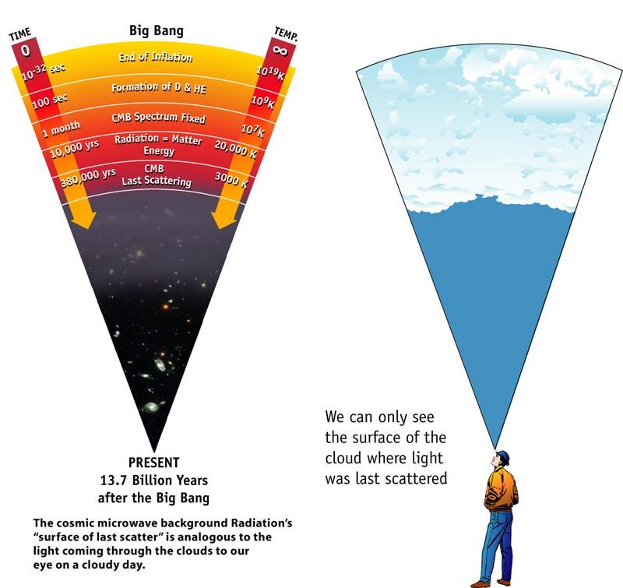
CMB: recombination and last scattering surface
The CMB anisotropies are a “Snapshot” of the universe taken at the epoch of recombination (z~1000), the so called last scattering surface.

Slide 24
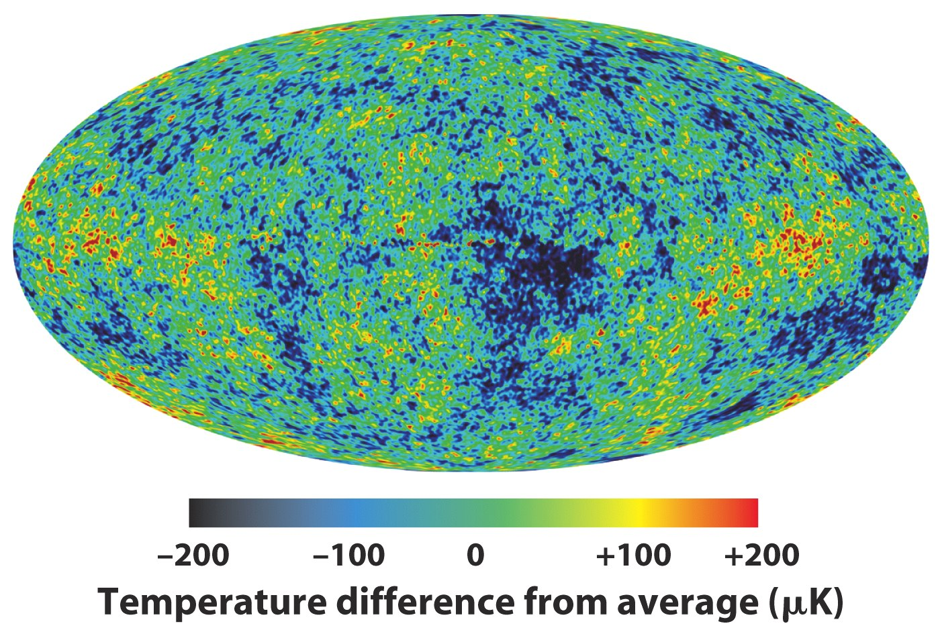
CMB anisotropies and cosmography.
CMB anisotropies are useful for cosmography in two ways.
  Peaks and valleys in Temperature correspond to valleys and peaks in the gravitational field at the time of recombination
  The pattern is modified as it travel through space time to get to us, recording the geometry of the Universe.

Slide 25
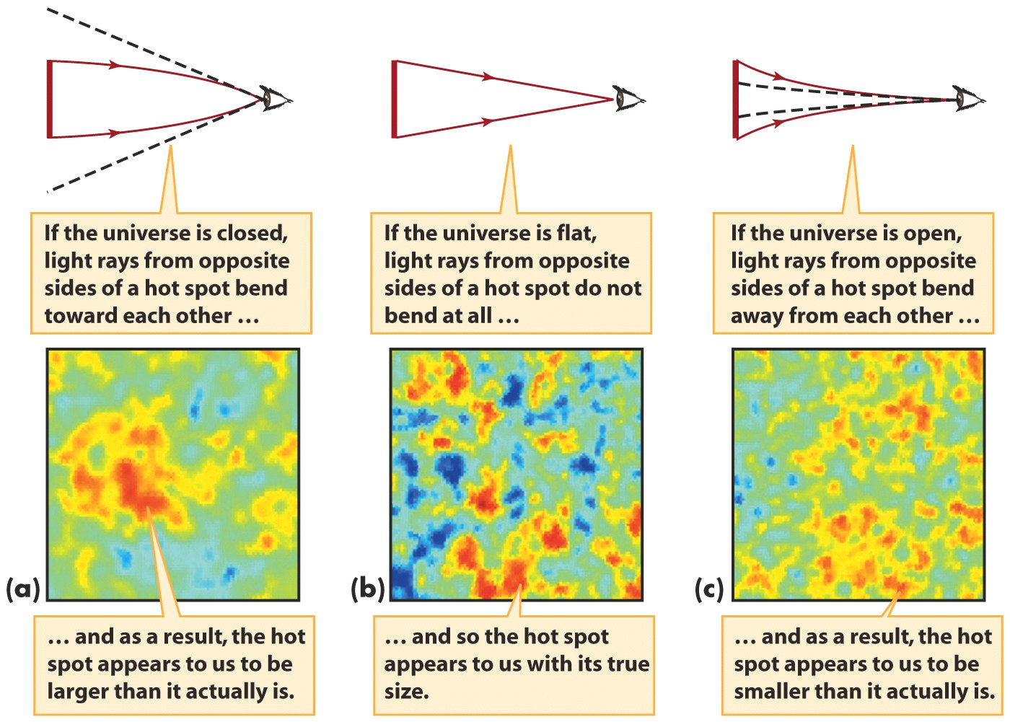
CMB anisotropies and cosmography. Light propagation
Credit NASA and the WMAP team; MOVIE (39)!

Slide 26
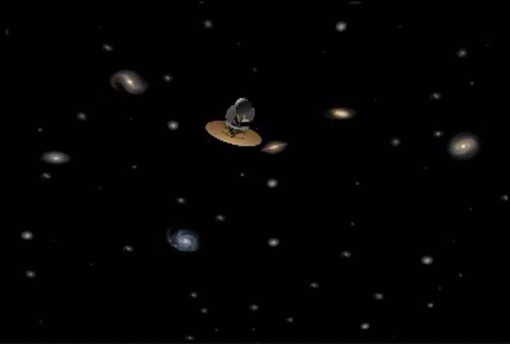
CMB anisotropies and cosmography. Light propagation

Slide 27
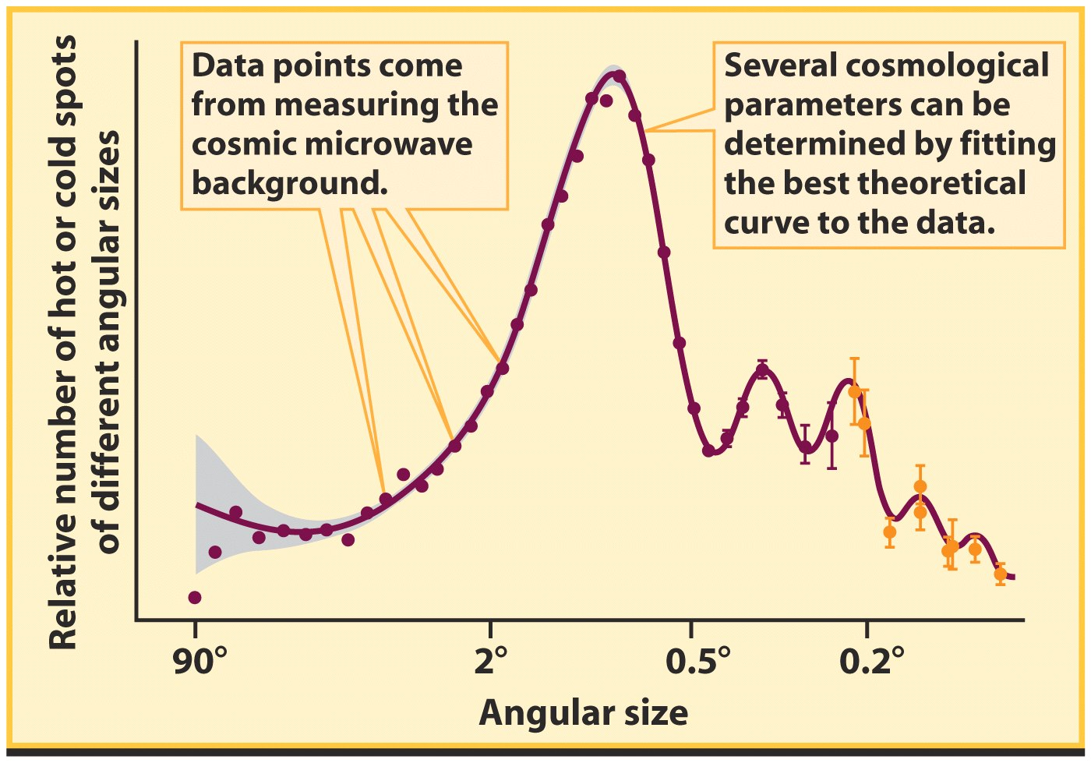
CMB anisotropies and cosmography. Acoustic peaks

Slide 28
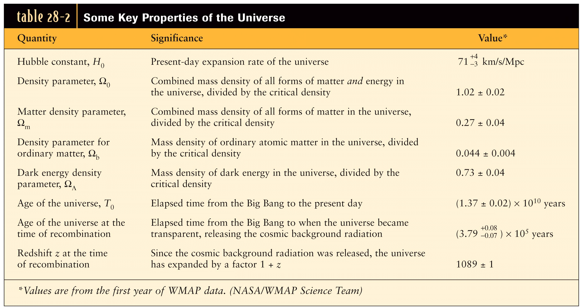
CMB anisotropies and cosmography. Results

Slide 29
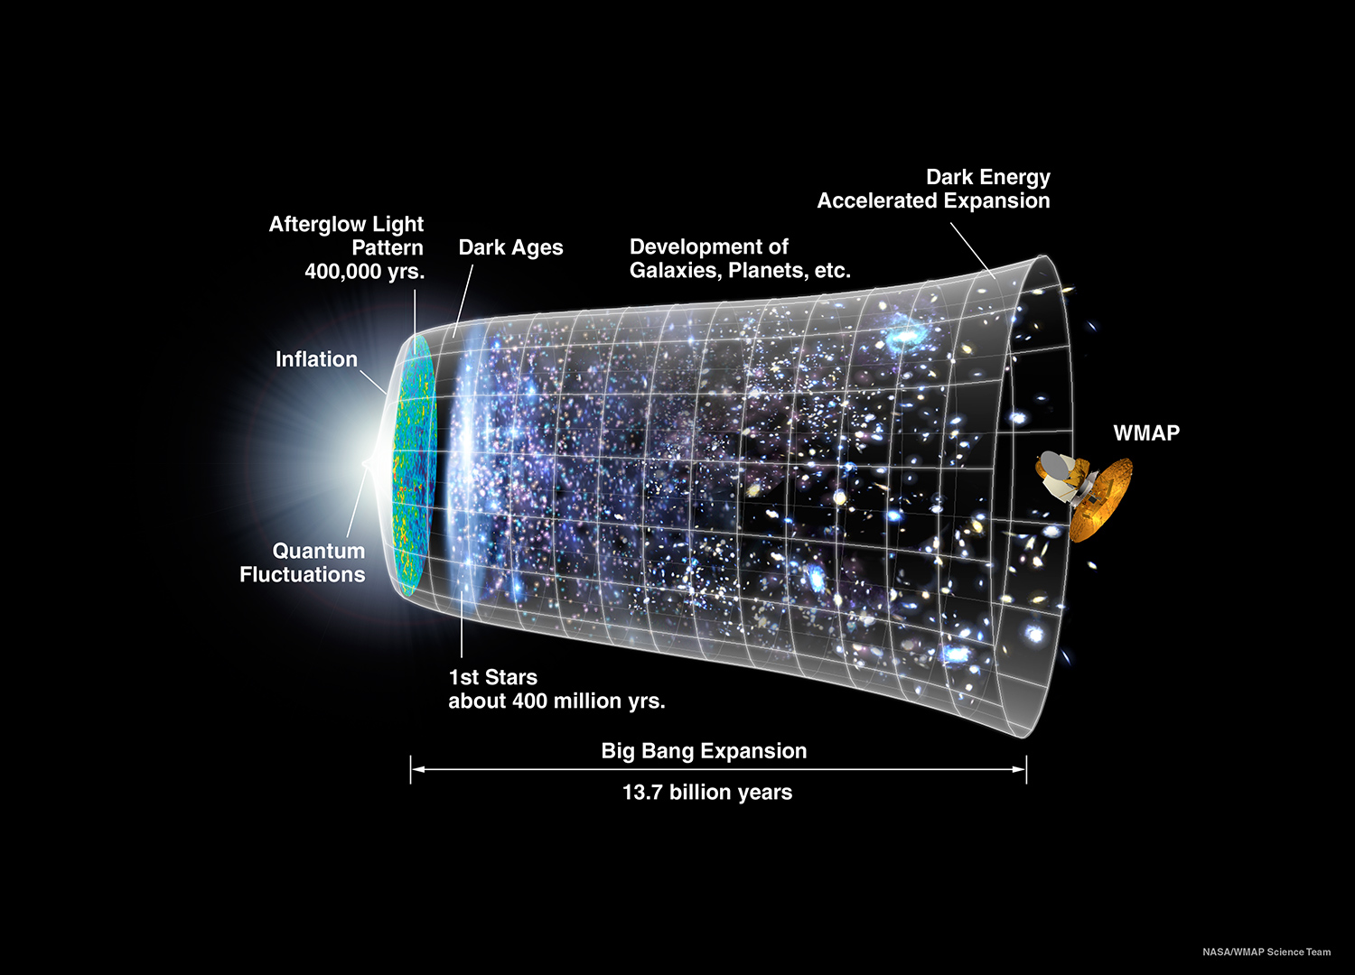
CMB anisotropies and cosmography. Results

Slide 30
CMB cosmography. Summary
CMB anisotropies are a snapshot of the universe at the last scattering surface at z~1000, when the universe was about 380,000 years old
They convey information about the content and geometry of the universe so that many parameters are known to a 10% or better.

Slide 31
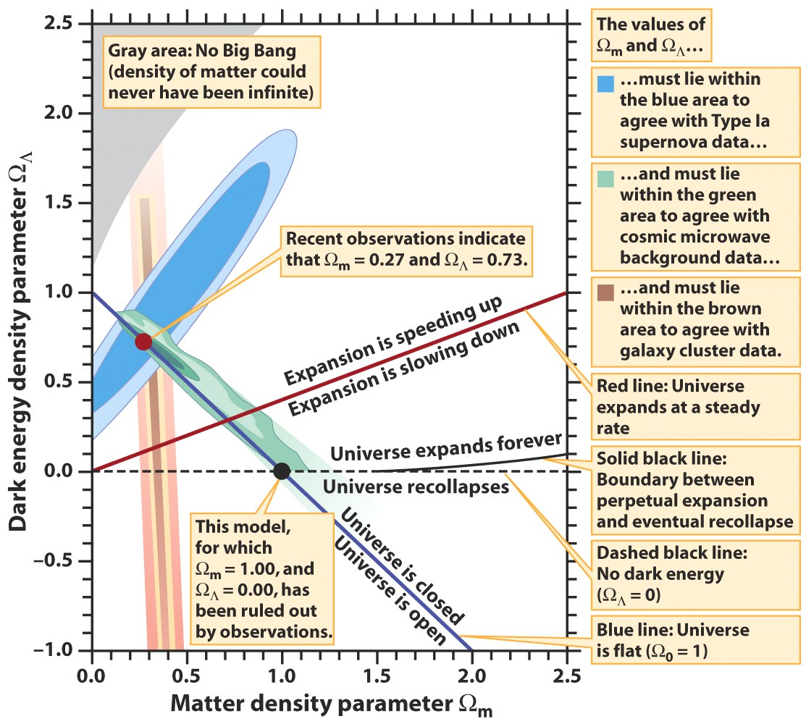
Concordance cosmology.
Happy campers?
Do the various methods agree?
They do!
This is called “concordance cosmology”

Slide 32


Concordance cosmology.
Happy campers?

Slide 33
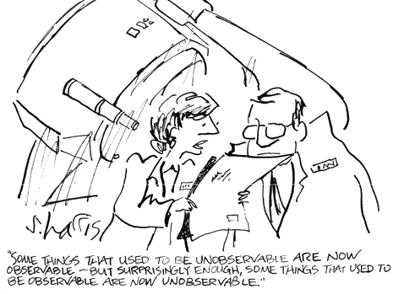
Acceleration and Horizons

Slide 34
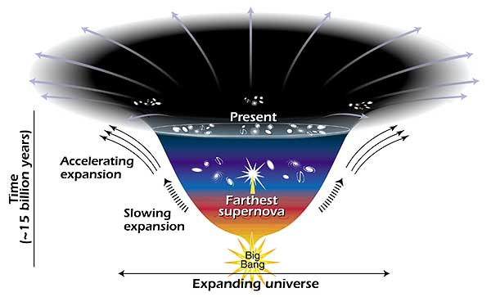
Acceleration and Horizons
The universe is expanding and accelerating
So the portion of the universe inside our visible horizon does not grow as fast as for a static universe
Depending on the properties of dark energy some objects may never be in our horizon, or even objects that are now in our horizon will not be in the future
Acceleration may even increase so much that the universe will be ripped apart “Big Rip” [movie]

Slide 35
The End
Thursday is midterm!

