Slide 1
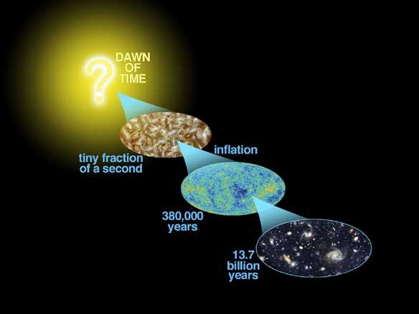
Astro-2: History of the Universe
Lecture 9; May 9 2013

Slide 2
Previously… on Astro-2.
Helium abundance.
Helium is too abundant and too homogeneous to have formed through fusion in stars
The Big Bang theory explains He abundance with primordial nucleosynthesis when the Universe was hot enough
T scales as (1+z), so that He was formed up to until z~100,000,000

Slide 3
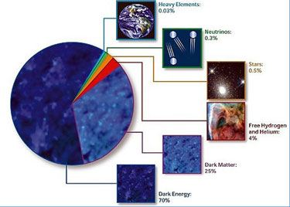
Previously on Astro-2. Matter density of the Universe.

Slide 4
Previously… on Astro-2.
A brief history of the universe.
Mass/energy density in various components scales with redshift as:
  Ω_{Λ}=Ω_{Λ,0} [Dark energy/Cosmological Constant]
  Ω_{m}=Ω_{m,0} (1+z)³ [Massive particles, i.e. baryons and dark matter]
  Ω_{rad}=Ω_{rad,0} (1+z)⁴ [Radiation]
At very high redshift (>5,000) radiation dominates (radiation dominated era)
Then matter dominates until very recently (z~0.4) when dark energy starts to dominate

Slide 5
Today… on Astro-2.
Big Bang models
Friedman Equation. Geometry and mass
Cosmological Constant

Slide 6
Big Bang Models. Geometry
Ingredients:
  The universe is homogeneous and isotropic
  The universe is a 4 dimensional space time as in General Relativity
  The dynamics of the Universe are described by General Relativity

Slide 7
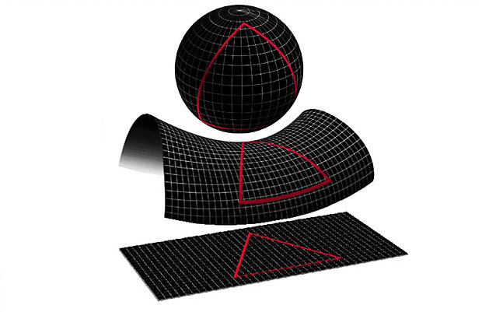
Big Bang Models. Geometry
Given the ingredients there are very general results for possible world models:
  Space and time can be “separated” so that we can define a cosmic time
  At any given time the universe is 3D space with a global curvature, which can be positive/zero/negative
The three geometries are referred to as closed/flat/open Universes
2D ANALOGS
POSITIVE
NEGATIVE
ZERO

Slide 8
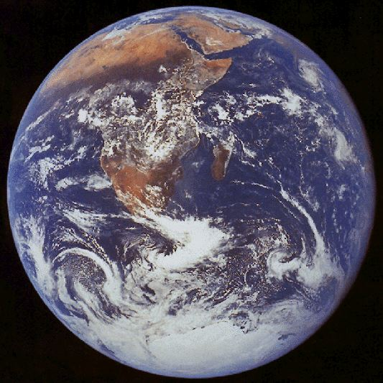
Big Bang Models.
Closed Universe
For a closed Universe we can draw from our experience as creatures living on Earth to understand some of the basic principles.
  There is no “edge” to the Earth surface, yet the surface is finite
  We can travel around the globe and get back to where we started moving always in the same direction
  Meridians cross at the poles, so straight divergent lines cross at some point
  The sum of the angles of a triangle is more than 180 degrees
  There is no CENTER on the surface of the Earth.

Slide 9
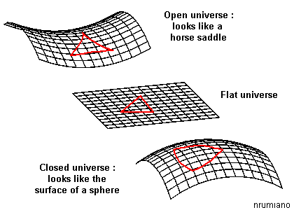
Big Bang Models.
Open Universe
Open universes are more difficult to relate to everyday experience. It’s like an infinite saddle:
  The surface is infinite so there is no edge
  The sum of the angles of a triangle is less than 180 degrees
  There is no CENTER because the surface is infinite

Slide 10
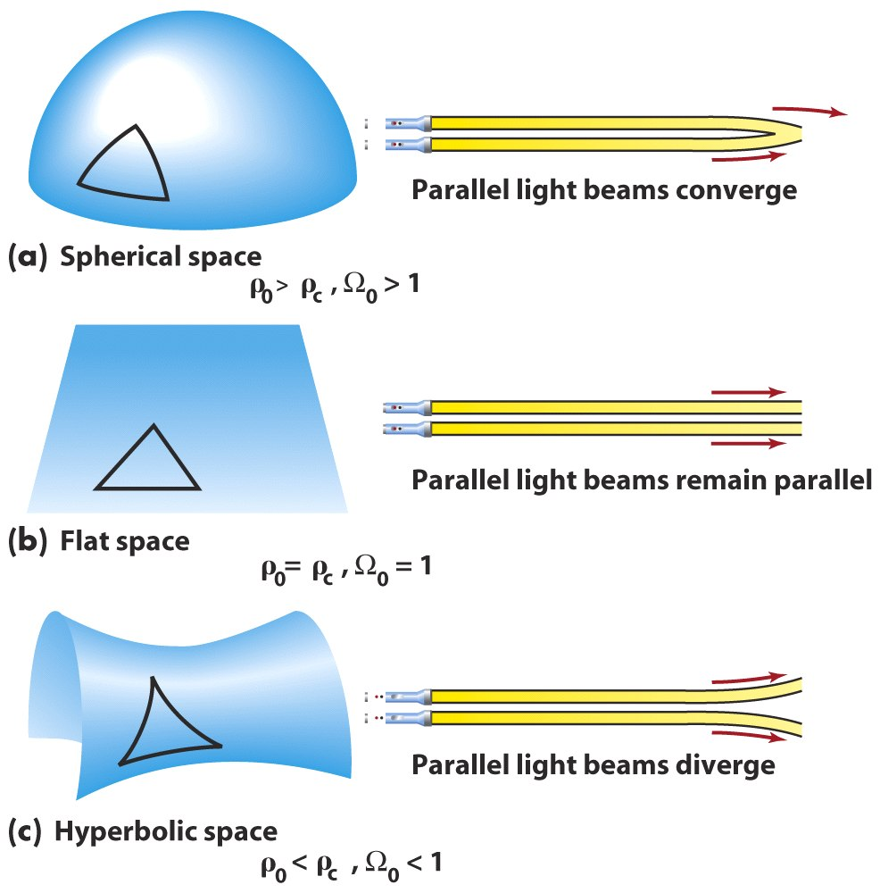
Big Bang Models.
Parallel lines

Slide 11
Big Bang Models. Geometry. Summary
If the universe is homogenous and isotropic and correctly described by General Relativity:
At any given time the universe is a 3D space
It could be open/close/flat
If it is close, its volume is finite. If it is open or flat its volume is infinite.
In any case THERE IS NO CENTER AND THERE ARE NO EDGES

Slide 12
The geometry of the universe. Discussion
“There is a single general space, a single vast immensity which we may freely call void: in it are innumerable globes like this on which we live and grow; this space we declare to be infinite, since neither reason, convenience, sense-perception nor nature assign to it a limit.” (Giordano Bruno)
“It is fairly certain that our space is finite though unbounded. Infinite space is simply a scandal to human tought” (Bishop Barnes)

Slide 13
Geometry and dynamics of the Universe
In general relativity geometry and mass are closely related.
The mass content of the universe determines its geometry AND its dynamics
In general, the dynamical evolution of the universe is determined by a single function that describes the evolution of distances as a function of time, called a(t)
Consider two points at a time t1 and t2. The ratio of the distances between the two points is a(t1)/a(t2)
Once we have a model of the universe we can compute a(t) and compare it with the observations

Slide 14
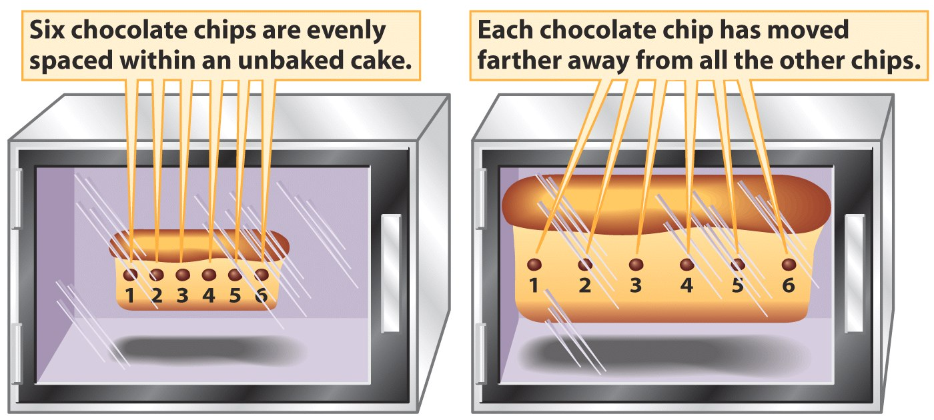
What does Hubble’s Law mean in this context?
Take us and a cluster at a distance of 1 Gpc now (t1). Hubble’s law says that the distance is increasing with time (“moving away”).
In billion years (t2) the cluster will be more distant
This means that a(t2)>a(t1)
This is true for any two points. Every two points are “moving away from each other” at this time.

Slide 15
Expansion and mass/geometry
The expansion rate, i.e. the ratio between velocity and distance (the generalization of the Hubble constant) can change with time.
This is exactly what we want to know!
Friedman’s Equation connects the Hubble parameter with the mass geometry of the Universe:
H²=H₀²[Ω_{rad,0}(1+z)⁴+Ω_{m,0}(1+z)³+Ω_{k}(1+z)²+Ω_{Λ}]
Ω_{k} is related to the overall geometry of time, being zero for a “flat” universe, negative for a closed universe and positive for an open universe
At early times (1+z)⁴ so when the universe is radiation dominated the other terms do not matter.

Slide 16
Expansion and geometry. Past and future of the Universe
By measuring the parameters we can determine the past and future of the Universe, as well as its overall geometry [Note that all Ω add up to 1 so that we can infer the geometry by measuring the other parameters]
For example, those parameters fix the current age of the universe and whether it will expand forever or recollapse, etc.

Slide 17
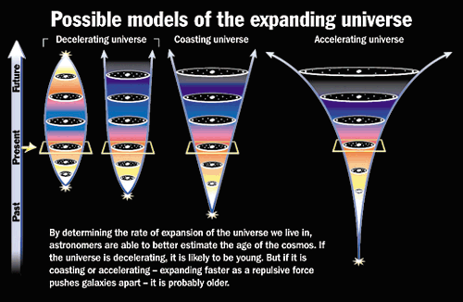
Past and future of the Universe

Slide 18
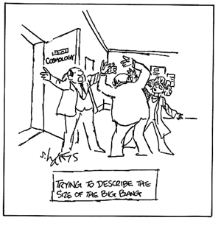
We need hypothesis and measurements…

Slide 19
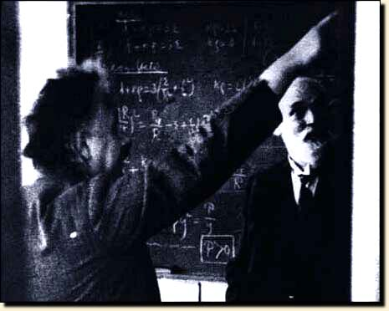
The Einstein-de Sitter Model
Einstein and de Sitter conjectured that only quantities known to be non-zero should be considered, everything else should be set to 0.
So they only kept mass… assuming no cosmological constant and flat space…
In this model the age of the universe is 2/3 (1/H₀).
Does this work?

Slide 20
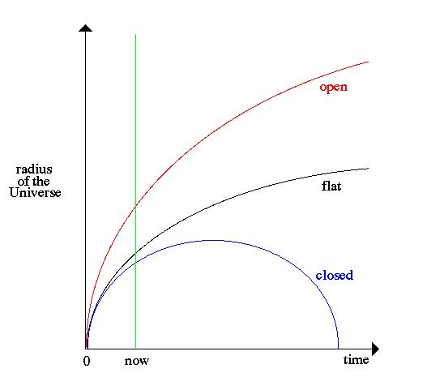
Geometry and mass
In a model with mass and curvature, you get a behavior like this, depending on the geometry of the universe.
Note that the critical mass density is the mass density required to have a flat universe in this model. If the density is supercritical the universe recollapses in a finite amount of time (the “big crunch”)

Slide 21
Friedmann equation. Summary
In the Big Bang model the “size” of the universe evolves according to the Friedmann equation.
Knowing the current value of the cosmological parameters (cosmography) we can calculate the past history of the Universe and predict its future.
The simplest models (e.g. Einstein-de Sitter) don’t work.

Slide 22
The cosmological constant
Soon after the completion of general relativity (1916) people used it to describe the universe.
However, with only matter there was no way to obtain a static solution, which at that time was the prejudice.
Einstein added the cosmological constant to his equations to find a static solution…

Slide 23
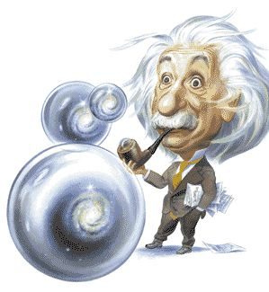
The cosmological constant
Unfortunately the static solution is unstable
And, when Hubble announced his discovery of the expansion, unnecessary
So the cosmological constant remained on the outskirts of cosmology for a long time…

Slide 24
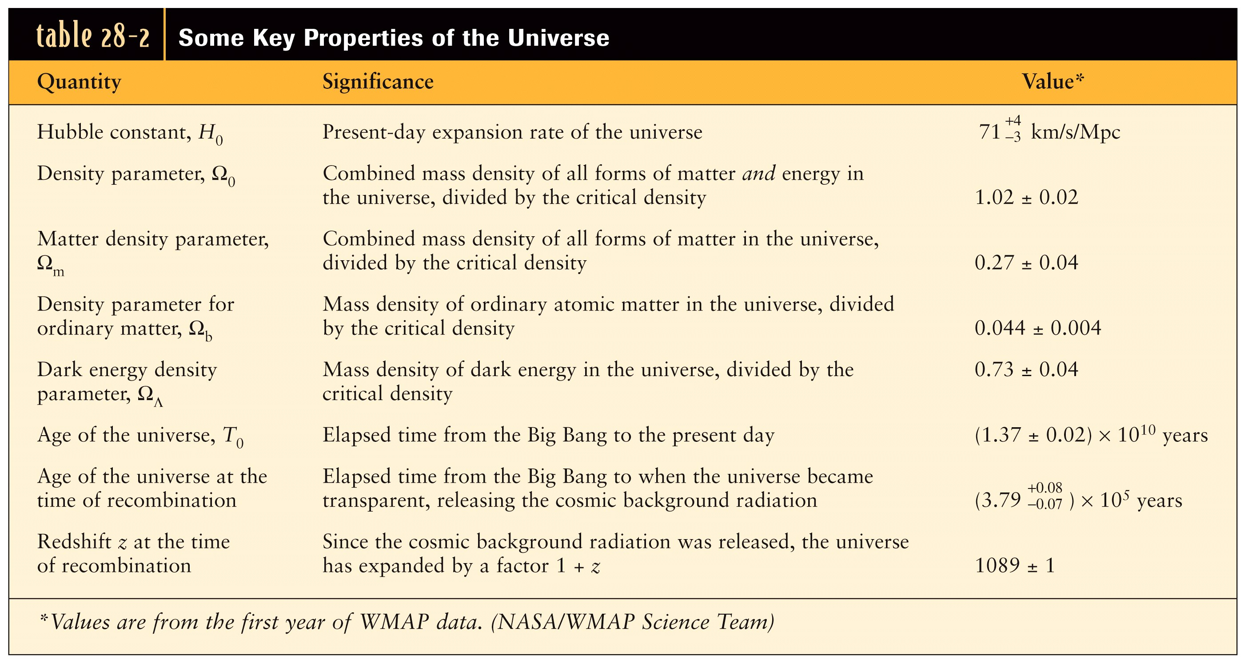
The cosmological constant is back!
And… by the way… the Universe is close to flat (more in lecture 12)

Slide 25

Cosmological constant or dark energy?
Nowadays people prefer to talk in terms of dark energy, instead of cosmological constant.
The classic cosmological constant point of view is a modification of Einstein’s equation adding an extra term
In the dark energy approach the extra component is interpreted as something with negative pressure filling space and people try to understand is a some sort of vacuum energy or some concept related to particle physics.
But we really don’t know…

Slide 26
The cosmological constant. Summary
The cosmological constant was initially introduce by Einstein to find a static solution for the universe (but it’s unstable!!)
When the universe was shown to expand the idea was abandoned
The cosmological constant was brought back by MEASUREMENTS (next lecture) a decade ago
Most people prefer to interpret the cosmological constant as dark energy and to give it a “particle physics” interpretation rather than a geometric one

Slide 27
Frequently asked questions…just checking…
What is the universe expanding into?
Nothing, the universe is all there is, space is expanding itself
Where is the center of the expansion? Where is the center of the universe
Nowhere, there is no center, the universe is homogenous and isotropic
Is the universe infinite/finite?
We do not know for sure but we think it’s infinite
Does it matter?
Not really because our horizon is finite

Slide 28
The End
See you on tuesday!

